Slide 2
For I do not understand my own actions. For I do not do what I want, but I do the very thing I hate…For I have the desire to do what is right, but not the ability to carry it out. For I do not do the good I want, but the evil I do not want is what I keep doing.
Wretched man that I am! Who will deliver me from this body of death?
Romans 7:15-19, 24

Slide 3
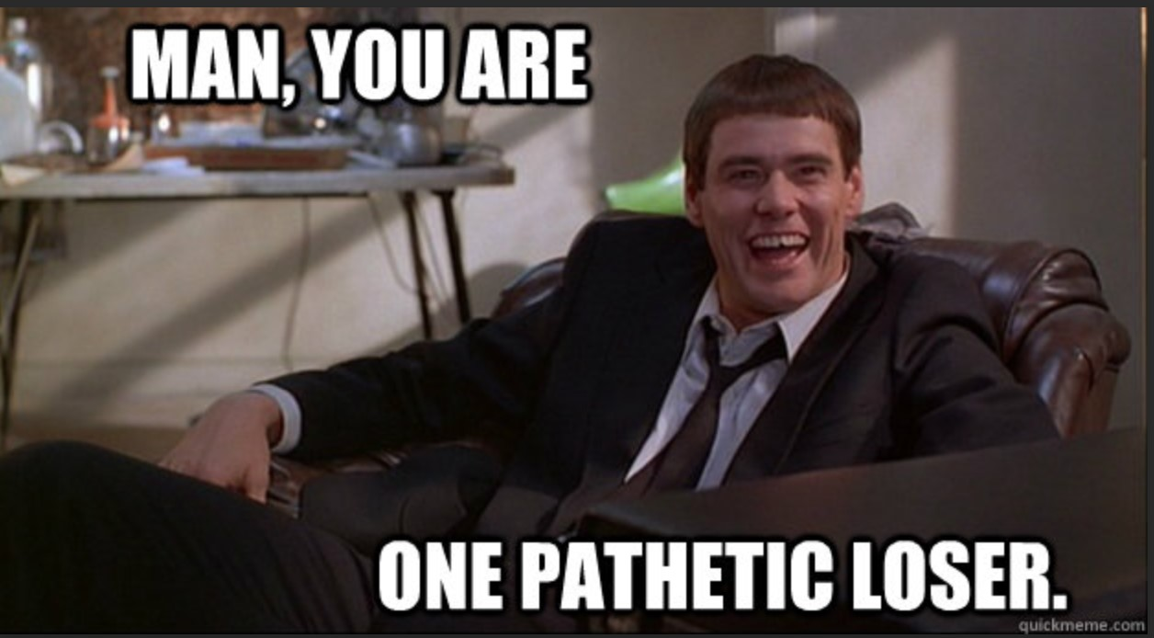

Slide 4
There is therefore now no condemnation for those who are in Christ Jesus. For the law of the Spirit of life has set you free in Christ Jesus from the law of sin and death.
Romans 8:1-2

Slide 5
Salvation through Christ – and the war continues.

Slide 6
For those who live according to the flesh set their minds on the things of the flesh, but those who live according to the Spirit set their minds on the things of the Sprit.
For to set the mind on the flesh is death, but to set the mind on the Spirit is life and peace.
Romans 8:5-6

Slide 7
Paul is waging this war:
For I delight in the law of God, in my inner being, but I see in my members another law waging war against the law of my mind and making me captive to the law of sin that dwells in my members.
Romans 7:22-23

Slide 8
For though we walk in the flesh, we are not waging war according to the flesh. For the weapons of our warfare are not of the flesh but have divine power to destroy strongholds.
2 Corinthians 10:3
For the mind that is set on the flesh is hostile to God, for it does not submit to God’s law; indeed, it cannot.
Romans 8:7

Slide 9
If you believe in Christ, wage this war in the Spirit.

Slide 10
You, however, are not in the flesh but in the Spirit, if in fact the Spirit of God dwells in you…If Christ is in you, although the body is dead because of sin, the Spirit is life because of righteousness.
If the Spirit of Him who raised Jesus from the dead dwells in you, He who raised Christ Jesus from the dead will also give life to your mortal bodies through His Spirit who dwells in you.
Romans 8:9-11

Slide 11
We are children of God! Romans 8:12-16
For you did not receive the spirit of slavery to fall back into fear, but you have received the Spirit of adoption, as children, by whom we cry, “Abba! Father!”
The Spirit himself bears witness with our spirit that we are the children of God.

Slide 12
You have an advocate – the Holy Spirit – who helps us in our weakness.
Romans 8:26

Slide 13
For we do not know what to pray for as we ought…
“Let’s make a deal…”
“If you answer this, I won’t ever ask for anything again…”
“If you give me this, I’ll give you…”
“Sometimes I thank God for unanswered prayers…”

Slide 14
Pray according to God’s perfect will for us.
Romans 8:16-28

Slide 15
The Spirit Himself intercedes for us with groanings too deep for words.
And he who searches hearts knows what is the mind of the Spirit, because the Spirit intercedes for the saints according to the will of God.

Slide 16
If God be for us, who can be against us?
(Satan accuses us.)
Who shall bring any charge against God’s elect? It is God who justifies. Who is to condemn? Christ?
Christ died and rose again, and is at God’s right hand, interceding for us.

